Slide 1
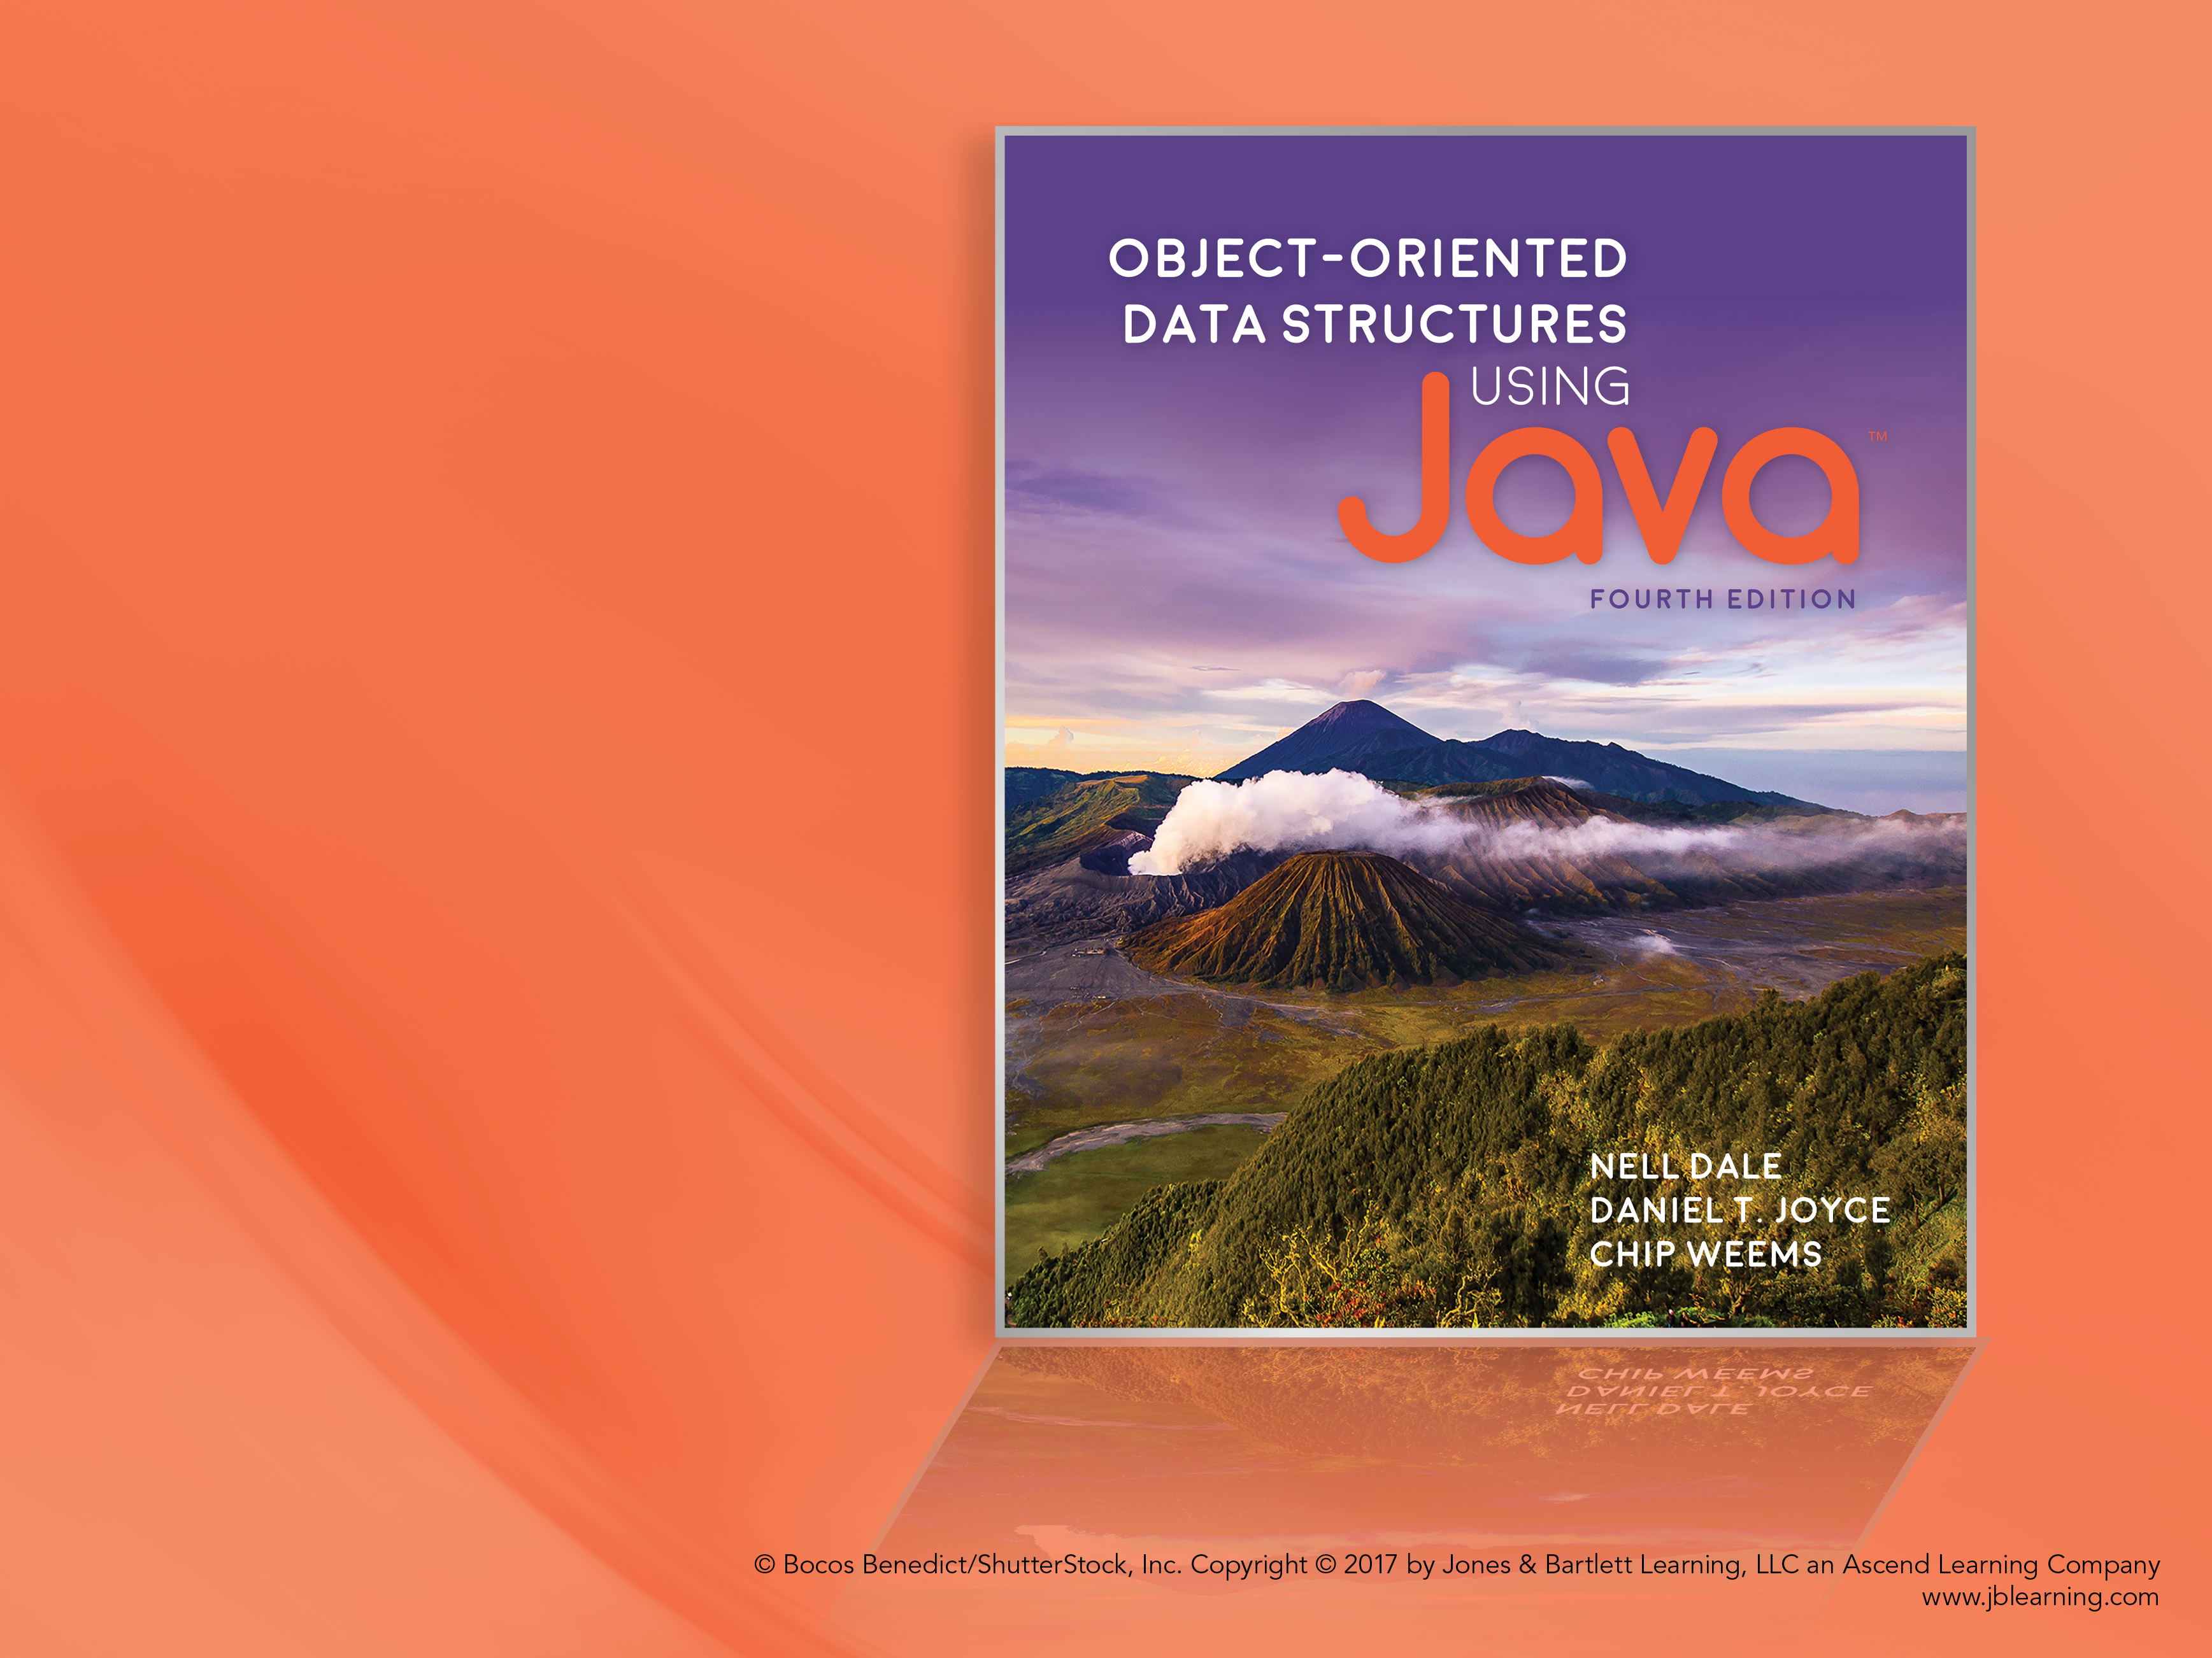
Chapter 2 The Stack ADT

Slide 2
Chapter 2: The Stack ADT
2.1 – Abstraction
2.2 – The Stack
2.3 – Collection Elements
2.4 – The Stack Interface
2.5 – Array-Based Stack Implementations
2.6 – Application: Balanced Expressions
2.7 – Introduction to Linked Lists
2.8 – A Link-Based Stack
2.9 – Application: Postfix Expression Evaluator
2.10 – Stack Variations

Slide 3
2.1 Abstraction
Abstraction A model of a system that includes only the details essential to the perspective of the viewer of the system
Information hiding The practice of hiding details within a module with the goal of controlling access to the details from the rest of the system
Data abstraction The separation of a data type’s logical properties from its implementation
Abstract data type (ADT) A data type whose properties (domain and operations) are specified independently of any particular implementation

Slide 4
ADT Perspectives or Levels
Application (or user or client or external) level: We use the ADT to solve a problem. When working at this level we only need to know how to create instances of the ADT and invoke its operations.
Abstract (or logical) level: Provides an abstract view of the data values (the domain) and the set of operations to manipulate them. At this level, we deal with the “what” questions. What is the ADT? What does it model? What are its responsibilities? What is its interface?
Implementation (or concrete or internal) level: Provides a specific representation of the structure to hold the data and the implementation of the operations. Here we deal with the “how” questions.

Slide 5
Preconditions and Postconditions
Preconditions Assumptions that must be true on entry into a method for it to work correctly
Postconditions or Effects The results expected at the exit of a method, assuming that the preconditions are true
We specify pre- and postconditions for a method in a comment at the beginning of the method

Slide 6
Java: Abstract Method
Only includes a description of its parameters
No method bodies or implementations are allowed.
In other words, only the interface of the method is included.

Slide 7
Java Interfaces
Similar to a Java class
can include variable declarations
can include methods
However
Variables must be constants
Methods must be abstract.
A Java interface cannot be instantiated.
We can use an interface to formally specify the logical level of an ADT:
It provides a template for classes to fill.
A separate class then "implements" it.
For example, see the FigureInterface interface and the Circle class (next slide) and Rectangle class (following slide) that implement it

Slide 8
FigureInterface
Circle Class
package ch02.figures;
public interface FigureInterface
{
final double PI = 3.14;
double perimeter();
// Returns perimeter of this figure.
double area();
// Returns area of this figure.
}
package ch02.figures;
public class Circle implements
FigureInterface
{
protected double radius;
public Circle(double radius)
{
this.radius = radius;
}
public double perimeter()
{
return(2 * PI * radius);
}
public double area()
{
return(PI * radius * radius);
}
}

Slide 9
FigureInterface
Rectangle Class
package ch02.figures;
public interface FigureInterface
{
final double PI = 3.14;
double perimeter();
// Returns perimeter of this figure.
double area();
// Returns area of this figure.
}
package ch02.figures;
public class Rectangle implements
FigureInterface
{
protected double length, width;
public Rectangle(double length,
double width)
{
this.length = length;
this.width = width;
}
public double perimeter()
{
return(2 * (length + width));
}
public double area()
{
return(length * width);
}
}

Slide 10
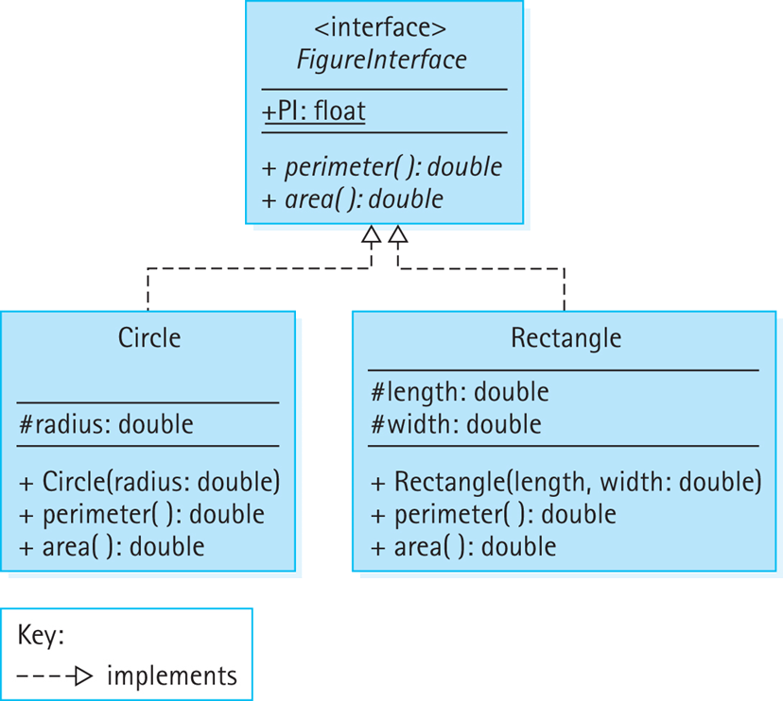
UML Class Diagram

Slide 11
Benefits from Using Interfaces
We can formally check the syntax of our specification. When we compile the interface, the compiler uncovers any syntactical errors in the method interface definitions.
We can formally verify that the interface “contract” is met by the implementation. When we compile the implementation, the compiler ensures that the method names, parameters, and return types match what was defined in the interface.
We can provide a consistent interface to applications from among alternate implementations of the ADT.

Slide 12
Interface-Based Polymorphism
Polymorphism – an object variable can reference objects of different classes at different times.
A variable declared to be of an interface “type” T can hold a reference to any object of class that implements that interface.
See example, next slide.

Slide 13
FigureInterface[] figures = new FigureInterface[COUNT];
final int COUNT = 5;
// generate figures
for (int i = 0; i < COUNT; i++)
{
switch (rand.nextInt(2))
{
case 0: figures[i] = new Circle(1.0);
break;
case 1: figures[i] = new Rectangle(1.0, 2.0);
break;
}
}
What is held in figures[3]?
We cannot predict. The binding of figures[3] to a class (Circle or Rectangle) occurs dynamically, at run time.
figures[3] is a polymorphic object.

Slide 14
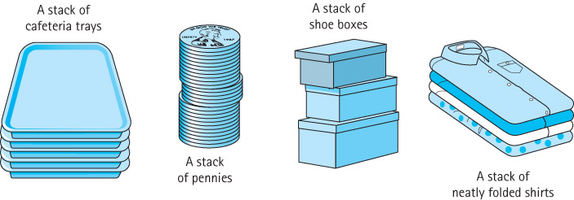
2.2 The Stack
Stack A structure in which elements are added and removed from only one end; a “last in, first out” (LIFO) structure

Slide 15
Operations on Stacks
Constructor
new - creates an empty stack
Transformers
push - adds an element to the top of a stack
pop - removes the top element off the stack
Observer
top - returns the top element of a stack

Slide 16
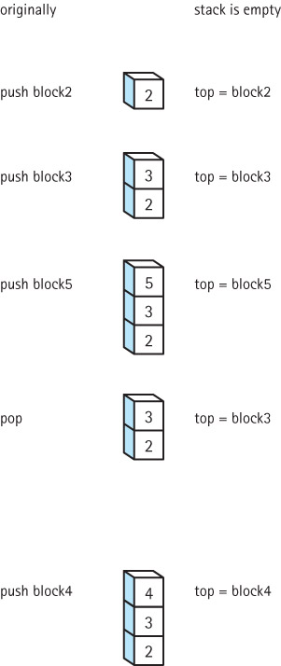
Effects of
Stack
Operations

Slide 17
Using Stacks
Stacks are often used for “system” programming:
Programming language systems use a stack to keep track of sequences of operation calls
Compilers use stacks to analyze nested language statements
Operating systems save information about the current process on a stack, so that it can work on a higher-priority, interrupting process
Stacks are good for storing “postponed obligations”

Slide 18
2.3 Collection Elements
Collection An object that holds other objects. Typically we are interested in inserting, removing, and obtaining the elements of a collection.
A stack is an example of a Collection ADT. It collects together elements for future use, while maintaining a first in – last out ordering among the elements.

Slide 19
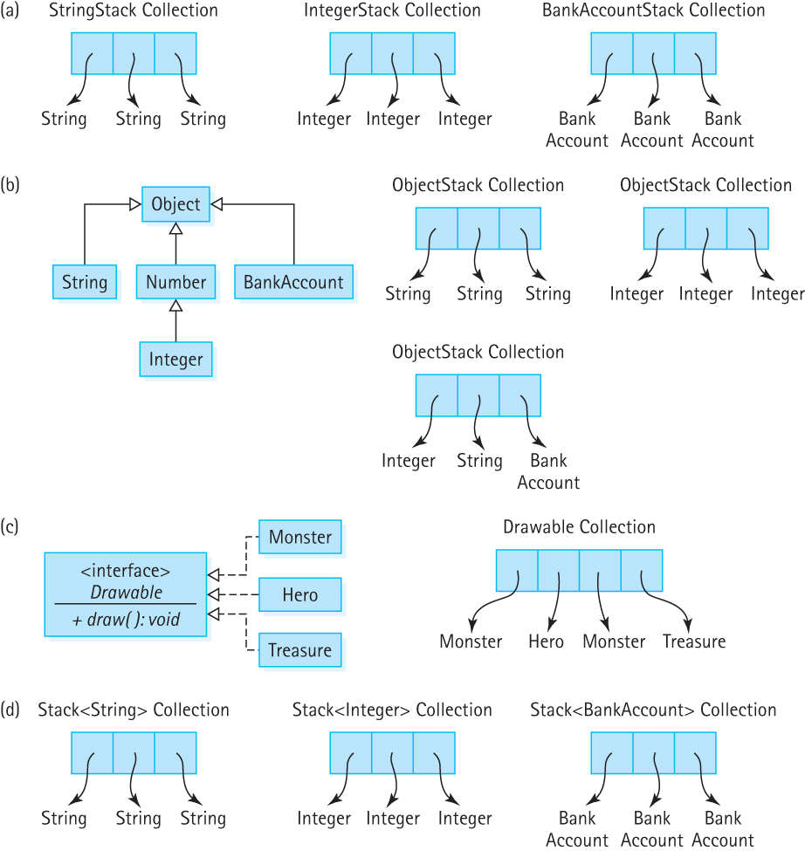
How can we implement stacks that hold different types of elements?
One approach is to implement a separate stack
class for each element type:
This approach is too redundant and not
generally useful.

Slide 20
How can we implement stacks that hold different types of elements?
Another approach is to implement a stack class
that can hold elements of class Object:
This approach requires extra effort to keep track
of, and indicate, exactly what is in the stack.

Slide 21
Collections of Class Object
Note: whenever an element is removed from the collection it can only be referenced as an Object. If you intend to use it as something else you must cast it into the type that you intend to use.
For example:
collection.push(“E. E. Cummings”); // push string on a stack
String poet = (String) collection.top(); // cast top to String
System.out.println(poet.toLowerCase()); // use the string

Slide 22
How can we implement stacks that hold different types of elements?
Another approach is to implement a stack class
that can hold elements of a particular interface:
This approach could work in certain specific situations
but it is not a general solution.

Slide 23
How can we implement stacks that hold different types of elements?
Generic stack – implement once and indicate the type
of element to be held on instantiation
This is the approach we will use:
Parameterized types
Declared as <T>
Actual type provided upon instantiation

Slide 24
Generic Collections
Example of beginning of Stack class definition:
Example of application declaring various stacks:
public class Stack<T>
{
protected T[ ] elements ;
protected int topIndex = -1;
...
Stack<Integer> numbers;
Stack<BankAccount> investments;
Stack<String> answers;

Slide 25
2.4 The Stack Interface
Recall from Section 2.1 that a stack is a "last-in first-out" structure, with primary operations
push - adds an element to the top of the stack
pop - removes the top element off the stack
top - returns the top element of a stack
In addition we need a constructor that creates an empty stack
Our Stack ADT will be a generic stack.
The class of elements that a stack stores will be specified by the client code at the time the stack is instantiated.

Slide 26
Exceptional Situations
pop and top – what if the stack is empty?
throw a StackUnderflowException
plus define an isEmpty method for use by the application
push – what if the stack is full?
throw a StackOverflowException
plus define an isFull method for use by the application

Slide 27
StackInterface
package ch02.stacks;
public interface StackInterface<T>
{
void push(T element) throws StackOverflowException;
// Throws StackOverflowException if this stack is full,
// otherwise places element at the top of this stack.
void pop() throws StackUnderflowException;
// Throws StackUnderflowException if this stack is empty,
// otherwise removes top element from this stack.
T top() throws StackUnderflowException;
// Throws StackUnderflowException if this stack is empty,
// otherwise returns top element of this stack.
boolean isFull();
// Returns true if this stack is full, otherwise returns false.
boolean isEmpty();
// Returns true if this stack is empty, otherwise returns false.
}

Slide 28
Example Use of a Stack
Instructors can now review and demonstrate the ReverseStrings application found in package ch02.apps.

Slide 29
2.5 Array-Based Implementations
In this section we study an array-based implementation of a bounded Stack ADT.
Additionally, we look at an alternate unbounded implementation that uses the Java Library ArrayList class.

Slide 30
The beginning of the ArrayBoundedStack Class
//---------------------------------------------------------------------
// ArrayBoundedStack.java Dale/Joyce/Weems Chapter 2
//
// Implements StackInterface using an array to hold stack elements.
//
// Two constructors are provided: one that creates an array of a default
// size and one that allows the calling program to specify the size.
//---------------------------------------------------------------------------
package ch02.stacks;
public class ArrayBoundedStack<T> implements StackInterface<T>
{
protected final int DEFCAP = 100; // default capacity
protected T[] elements; // holds stack elements
protected int topIndex = -1; // index of top element in stack
public ArrayBoundedStack()
{
elements = (T[]) new Object[DEFCAP];
}
public ArrayBoundedStack(int maxSize)
{
elements = (T[]) new Object[maxSize];
}

Slide 31
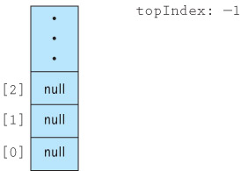
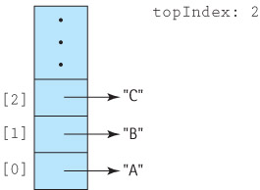
Visualizing the stack
The empty stack:
After pushing “A”, “B” and “C”:

Slide 32
Definitions of Stack Operations
public boolean isEmpty()
// Returns true if this stack is empty, otherwise returns false.
{
return (topIndex == -1);
}
public boolean isFull()
// Returns true if this stack is full, otherwise returns false.
{
return (topIndex == (elements.length - 1));
}

Slide 33
Definitions of Stack Operations
public void push(T element)
{
if (isFull())
throw new StackOverflowException("Push attempted on a full stack.");
else
{
topIndex++;
elements[topIndex] = element;
}
}
public void pop()
{
if (isEmpty())
throw new StackUnderflowException("Pop attempted on empty stack.");
else
{
elements[topIndex] = null;
topIndex--;
}
}

Slide 34
Definitions of Stack Operations
public T top()
{
T topOfStack = null;
if (isEmpty())
throw new StackUnderflowException("Top attempted on empty stack.");
else
topOfStack = elements[topIndex];
return topOfStack;
}

Slide 35
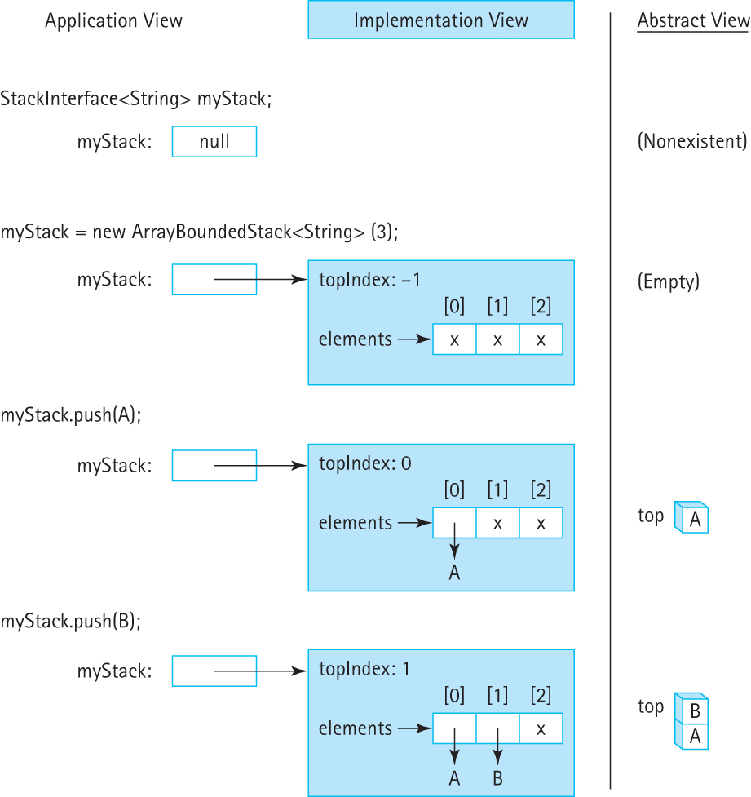
Figure depicts Application,
Implementation and Abstract
views of the code sequence:
StackInterface<String> myStack;
myStack = new
ArrayBoundedStack<String>(3);
myStack.push(A);
myStack.push(B);

Slide 36
The beginning of the ArrayListStack Class
//---------------------------------------------------------------------------
// ArrayListStack.java by Dale/Joyce/Weems Chapter 2
//
// Implements an unbounded stack using an ArrayList.
//---------------------------------------------------------------------------
package ch02.stacks;
import java.util.*;
public class ArrayListStack<T> implements StackInterface<T>
{
protected ArrayList<T> elements; // ArrayList that holds stack elements
public ArrayListStack()
{
elements = new ArrayList<T>();
}

Slide 37
Definitions of Stack Operations
public boolean isEmpty()
// Returns true if this stack is empty, otherwise returns false.
{
return (elements.size() == 0);
}
public boolean isFull()
// Returns false – an ArrayListStack is never full.
{
return false;
}

Slide 38
Definitions of Stack Operations
public void push(T element)
{
elements.add(element);
}
public void pop()
{
if (isEmpty())
throw new StackUnderflowException("Pop attempted on empty stack.");
else
elements.remove(elements.size() - 1);
}
public T top()
{
T topOfStack = null;
if (isEmpty())
throw new StackUnderflowException("Top attempted on empty stack.");
else
topOfStack = elements.get(elements.size() - 1);
return topOfStack;
}

Slide 39
2.6 Application: Balanced Expressions
Given a set of grouping symbols, determine if the open and close versions of each symbol are matched correctly.
We’ll focus on the normal pairs, (), [], and {}, but in theory we could define any pair of symbols (e.g., < > or / \) as grouping symbols.
Any number of other characters may appear in the input expression, before, between, or after a grouping pair, and an expression may contain nested groupings.
Each close symbol must match the last unmatched opening symbol and each open grouping symbol must have a matching close symbol.

Slide 40
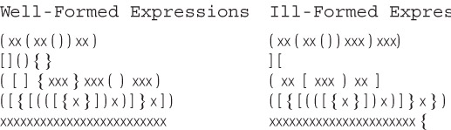
Examples

Slide 41
The Balanced Class
To help solve our problem we create a class called Balanced, with two instance variables of type String (openSet and closeSet) and a single exported method test
The Constructor is:
public Balanced(String openSet, String closeSet)
// Preconditions: No character is contained more than once in the
// combined openSet and closeSet strings.
// The size of openSet == the size of closeSet.
{
this.openSet = openSet;
this.closeSet = closeSet;
}

Slide 42
The test method
Takes an expression as a string argument and checks to see if the grouping symbols in the expression are balanced.
We use an integer to indicate the result:
0 means the symbols are balanced, such as (([xx])xx)
1 means the expression has unbalanced symbols, such as (([xx}xx))
2 means the expression came to an end prematurely, such as (([xxx])xx

Slide 43
The test method
For each input character, it does one of three tasks:
If the character is an open symbol, it is pushed on a stack.
If the character is a close symbol, it must be checked against the last open symbol, which is obtained from the top of the stack. If they match, processing continues with the next character. If the close symbol does not match the top of the stack, or if the stack is empty, then the expression is ill-formed.
If the character is not a special symbol, it is skipped.

Slide 44
Test for Well-Formed Expression Algorithm (String expression)
Create a new stack of size equal to the length of subject
Set stillBalanced to true
Get the first character from expression
while (the expression is still balanced
AND
there are still more characters to process)
Process the current character
Get the next character from expression
if (!stillBalanced)
return 1
else if (stack is not empty)
return 2
else
return 0

Slide 45
Expansion of “Process the current character”
if (the character is an open symbol)
Push the open symbol character onto the stack
else if (the character is a close symbol)
if (the stack is empty)
Set stillBalanced to false
else
Set open symbol character to the value at the top of the stack
Pop the stack
if the close symbol character does not “match” the open symbol character
Set stillBalanced to false
else
Skip the character

Slide 46
Code and Demo
Instructors can now walk through the code contained in Balanced.java found in the ch02.balanced package and BalancedCLI.java and/or BalancedGUI.java found in the ch02.apps package, review the notes on pages 104 and 105, and demonstrate the running program.

Slide 47
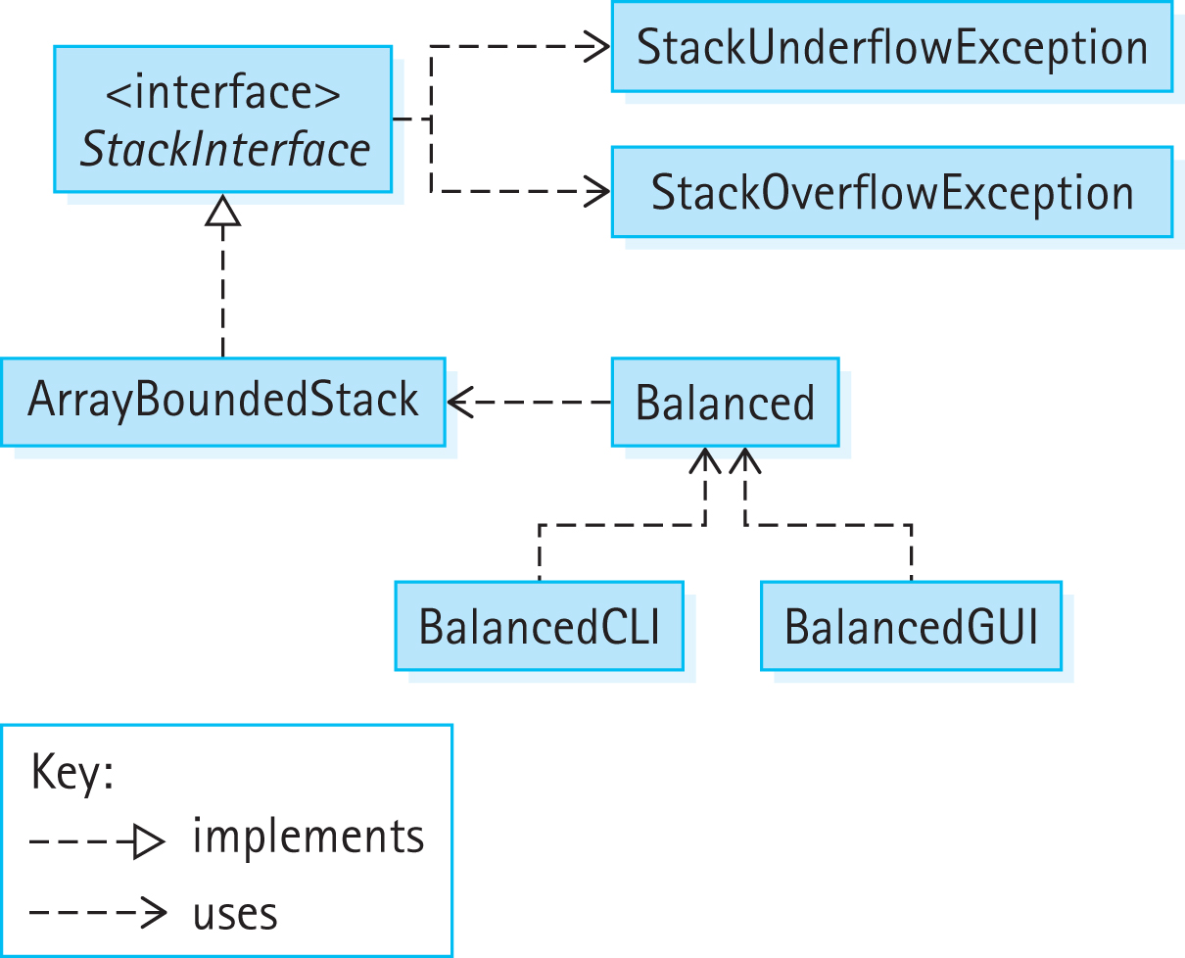
Program Architecture

Slide 48
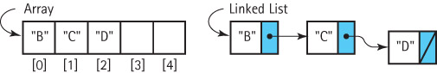
2.7 Introduction to Linked Lists
Arrays and Linked Lists are both basic building blocks for implementing data structures.
They differ in terms of
use of memory
manner of access
efficiency for various operations
language support

Slide 49
Nodes of a Linked-List
A node in a linked list is an object that holds some important information, such as a string, plus a link to the exact same type of object, i.e. to an object of the same class.
Self-referential class A class that includes an instance variable or variables that can hold a reference to an object of the same class.
To support our linked implementations of our ADTs we create the self-referential LLNode class …

Slide 50
LLNode Class
//---------------------------------------------------
// LLNode.java by Dale/Joyce/Weems Chapter 2
//
// Implements <T> nodes for a Linked List.
//---------------------------------------------------
package support;
public class LLNode<T>
{
protected T info;
protected LLNode<T> link;
public LLNode(T info)
{
this.info = info;
link = null;
}
public void setInfo(T info){ this.info = info;}
public T getInfo(){ return info; }
public void setLink(LLNode<T> link){ this.link = link;}
public LLNode<T> getLink(){ return link;}
}

Slide 51
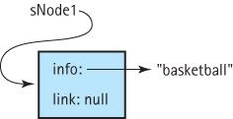
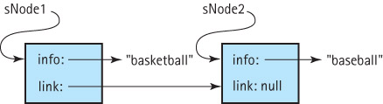
Using the LLNode class
1: LLNode<String> sNode1 = new LLNode<String>("basketball");
2: suppose that in addition to sNode1 we have sNode2 with info “baseball” and perform
sNode1.setLink(sNode2);

Slide 52
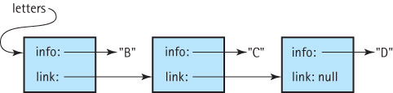
Traversal of a Linked List
LLNode<String> currNode = letters;
while (currNode != null)
{
System.out.println(currNode.getInfo());
currNode = currNode.getLink();
}

Slide 53
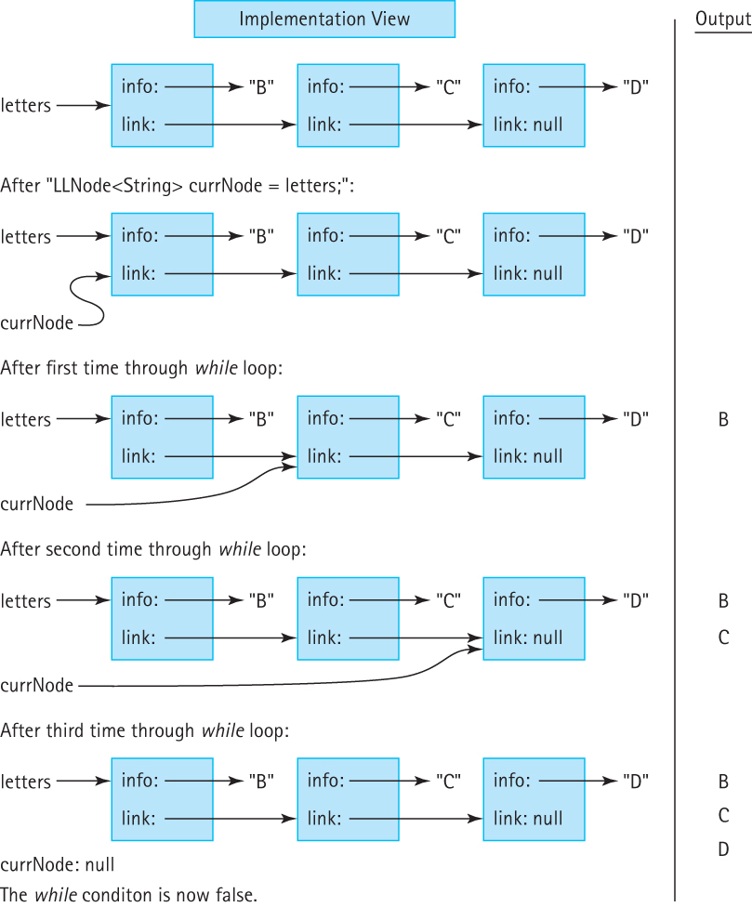
Tracing a Traversal (part 1)
LLNode<String> currNode = letters;
while (currNode != null)
{
System.out.println(currNode.getInfo());
currNode = currNode.getLink();
}
Internal View
Output

Slide 54
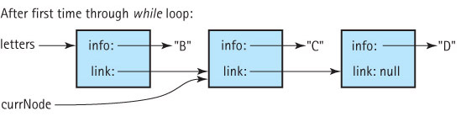
Tracing a Traversal (part 2)
LLNode<String> currNode = letters;
while (currNode != null)
{
System.out.println(currNode.getInfo());
currNode = currNode.getLink();
}
Internal View
Output
B

Slide 55
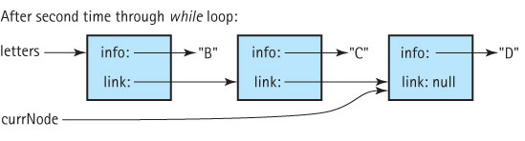
Tracing a Traversal (part 3)
LLNode<String> currNode = letters;
while (currNode != null)
{
System.out.println(currNode.getInfo());
currNode = currNode.getLink();
}
Internal View
Output
B
C

Slide 56
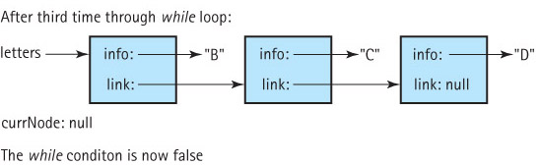
Tracing a Traversal (part 4)
LLNode<String> currNode = letters;
while (currNode != null)
{
System.out.println(currNode.getInfo());
currNode = currNode.getLink();
}
Internal View
Output
B
C
D

Slide 57
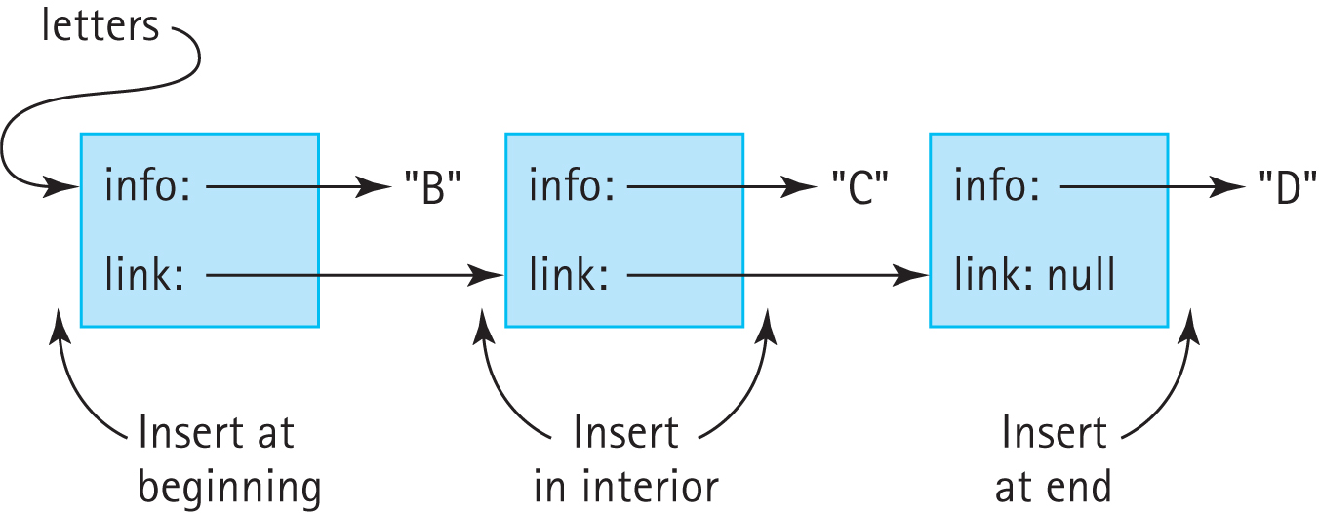
Three general cases of insertion

Slide 58
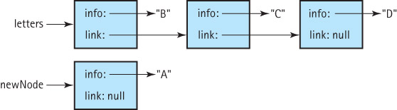
Insertion at the front (part 1)
Suppose we have the node newNode to insert into the beginning of the letters linked list:

Slide 59
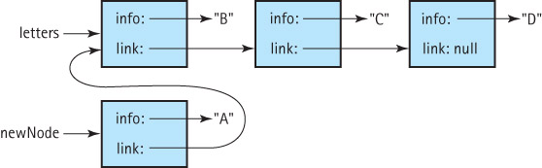
Insertion at the front (part 2)
Our first step is to set the link variable of the newNode node to point to the beginning of the list :
newNode.setLink(letters);

Slide 60
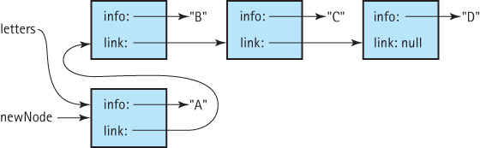
Insertion at the front (part 3)
To finish the insertion we set the letters variable to point to the newNode, making it the new beginning of the list:
letters = newNode;

Slide 61
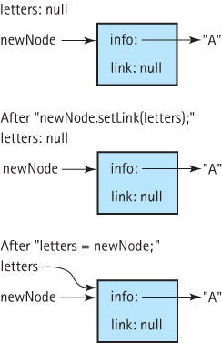
Insertion at front of an empty list
The insertion at the front code is
newNode.setLink(letters);
letters = newNode;
What happens if our insertion code is called when the linked list is empty?
As can be seen at the right the code still works, with the new node becoming the first and only node on the linked list.

Slide 62
2.8 A Link-Based Stack
In this section we study a link-based implementation of the Stack ADT.
After discussing the link-based approach we compare our stack implementation approaches.

Slide 63
The LinkedStack Class
We only need a single instance variable, the “pointer” to
the ‘top’ of the stack:
package ch02.stacks;
import support.LLNode;
public class LinkedStack<T> implements StackInterface<T>
{
protected LLNode<T> top; // reference to the top of this stack
public LinkedStack()
{
top = null;
}
. . .

Slide 64
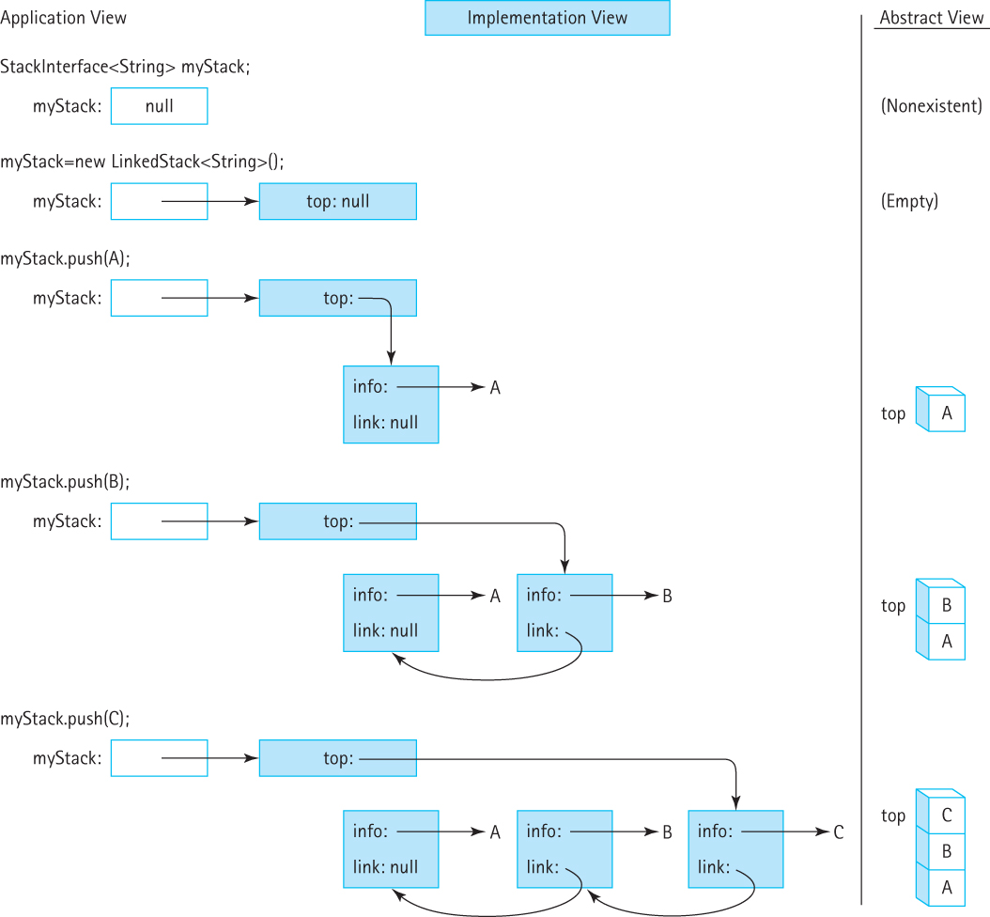
Visualizing the push operation
(insertion at front of a linked-list)
StackInterface<String> myStack;
myStack = new LinkedStack<String>();
myStack.push(A);
myStack.push(B);
myStack.push(C);

Slide 65
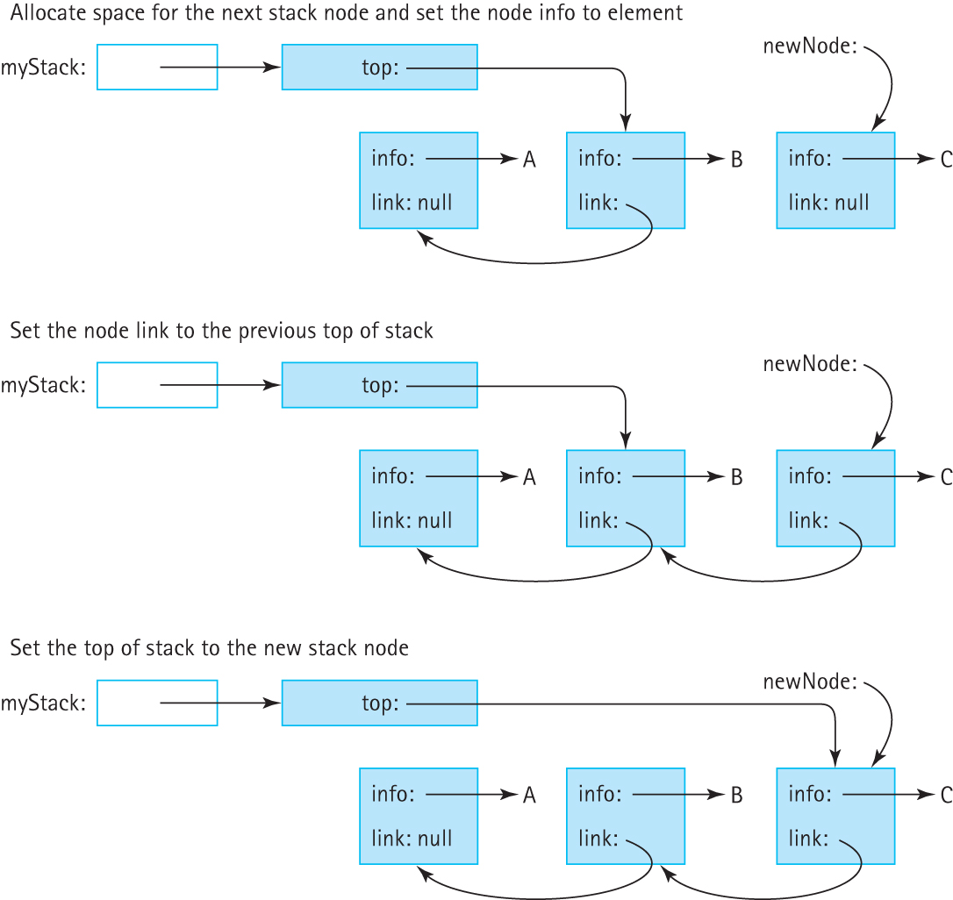
The push(C) operation (step 1)
Allocate space for the next stack node
and set the node info to element
Set the node link to the previous top of stack
Set the top of stack to the new stack node

Slide 66
The push(C) operation (step 2)
Allocate space for the next stack node
and set the node info to element
Set the node link to the previous top of stack
Set the top of stack to the new stack node

Slide 67
The push(C) operation (step 3)
Allocate space for the next stack node
and set the node info to element
Set the node link to the previous top of stack
Set the top of stack to the new stack node

Slide 68
Code for the push method
public void push(T element)
// Places element at the top of this stack.
{
LLNode<T> newNode = new LLNode<T>(element);
newNode.setLink(top);
top = newNode;
}

Slide 69
Result of push onto empty stack

Slide 70
Code for the pop method
public void pop()
// Throws StackUnderflowException if this stack is empty,
// otherwise removes top element from this stack.
{
if (isEmpty())
throw new StackUnderflowException("Pop attempted on an empty stack.");
else
top = top.getLink();
}

Slide 71
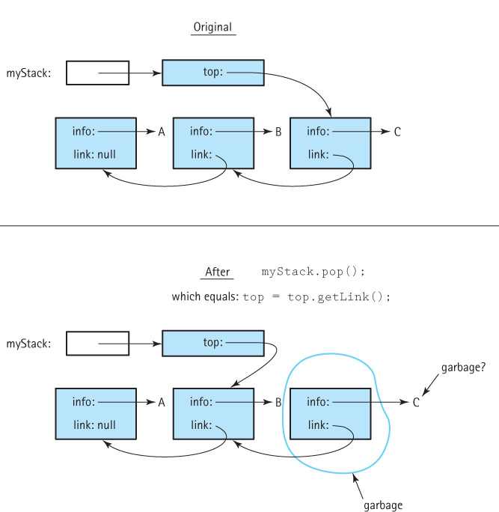
Pop from
a stack
with three
elements

Slide 72
The remaining operations
public T top()
{
if (isEmpty())
throw new StackUnderflowException("Top attempted on an empty stack.");
else
return top.getInfo();
}
public boolean isEmpty()
{
return (top == null);
}
public boolean isFull()
// Returns false – a linked stack is never full.
{
return false;
}

Slide 73
Comparing Stack Implementations
Storage Size
Array-based: takes the same amount of memory, no matter how many array slots are actually used, proportional to maximum size
Link-based: takes space proportional to actual size of the stack (but each element requires more space than with array approach)
Operation efficiency
All operations, for each approach, are O(1)
Except for the Constructors:
Array-based: O(N)
Link-based: O(1)

Slide 74
Which is better?
The linked implementation does not have space limitations, and in applications where the number of stack elements can vary greatly, it wastes less space when the stack is small.
The array-based implementation is short, simple, and efficient. Its operations have less overhead. When the maximum size is small and we know the maximum size with certainty, the array-based implementation is a good choice.

Slide 75
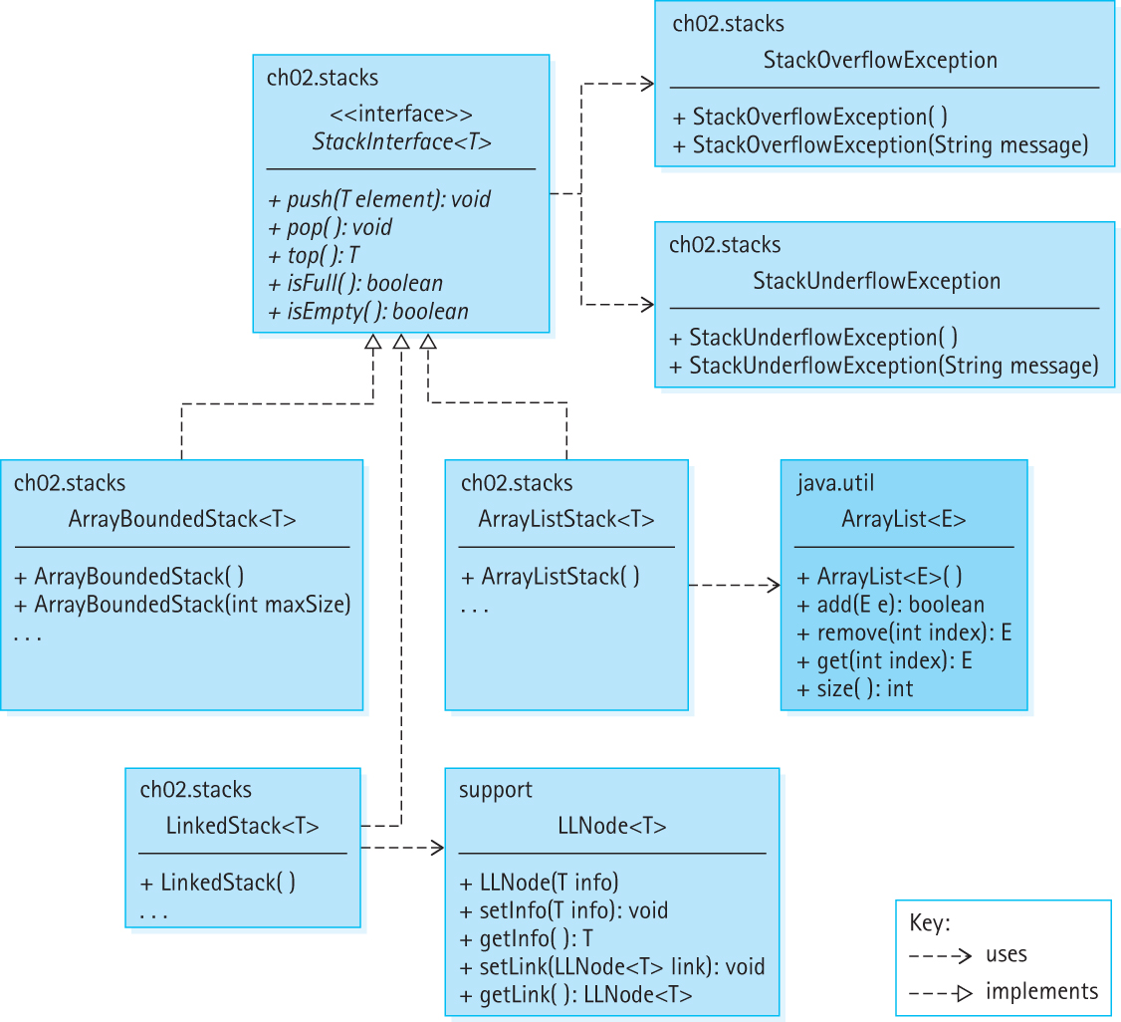
Our
Stack
Classes
and
Interfaces

Slide 76
2.9 Application: Postfix Expression Evaluator
Postfix notation is a notation for writing arithmetic expressions in which the operators appear after their operands.
For example, instead of writing
(2 + 14) × 23
we write
2 14 + 23 ×

Slide 77
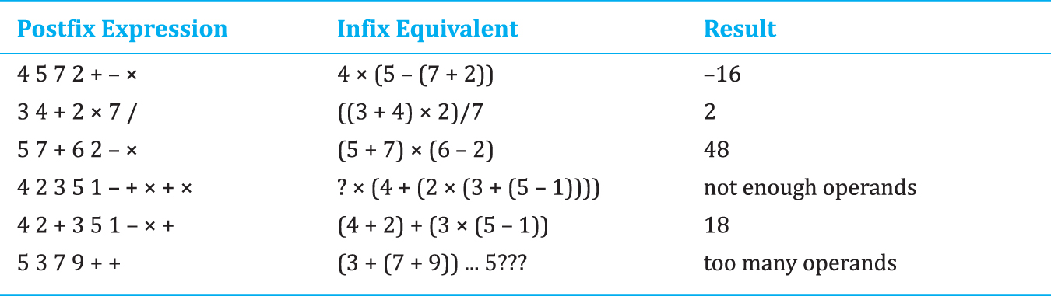
Examples

Slide 78
Postfix Expression Evaluation Algorithm
while more items exist
Get an item
if item is an operand
stack.push(item)
else
operand2 = stack.top()
stack.pop()
operand1 = stack.top()
stack.pop()
Set result to (apply operation corresponding to item
to operand1 and operand2)
stack.push(result)
result = stack.top()
stack.pop()
return result

Slide 79
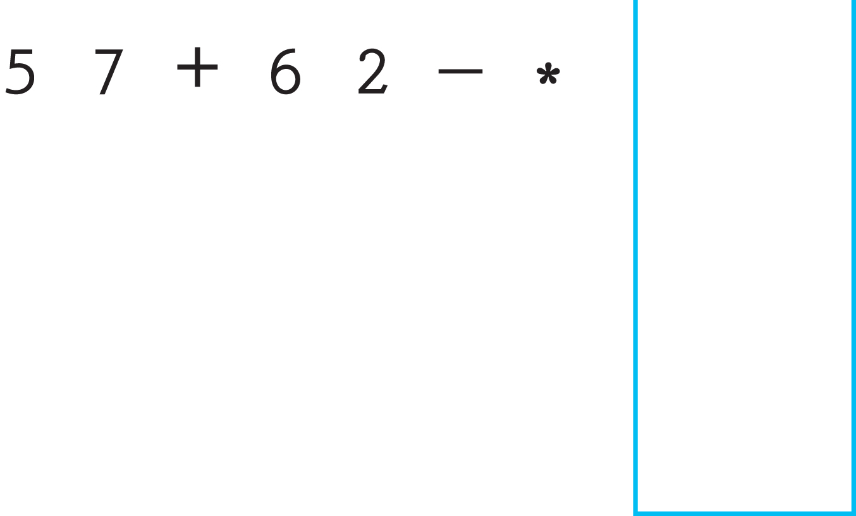
Example

Slide 80
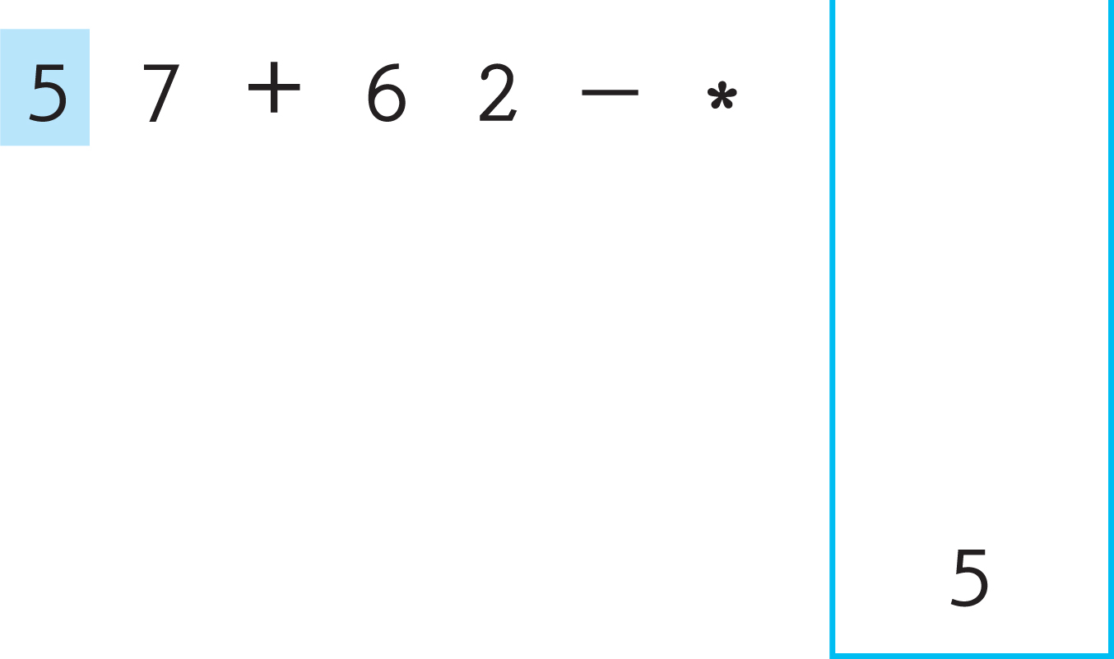
Example

Slide 81
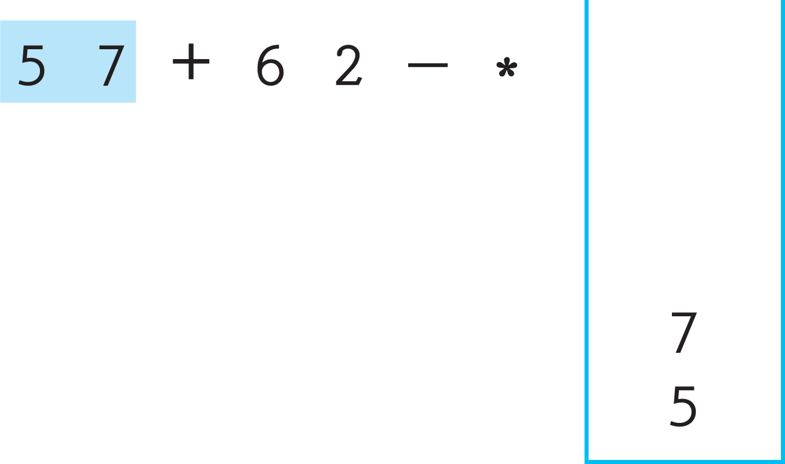
Example

Slide 82
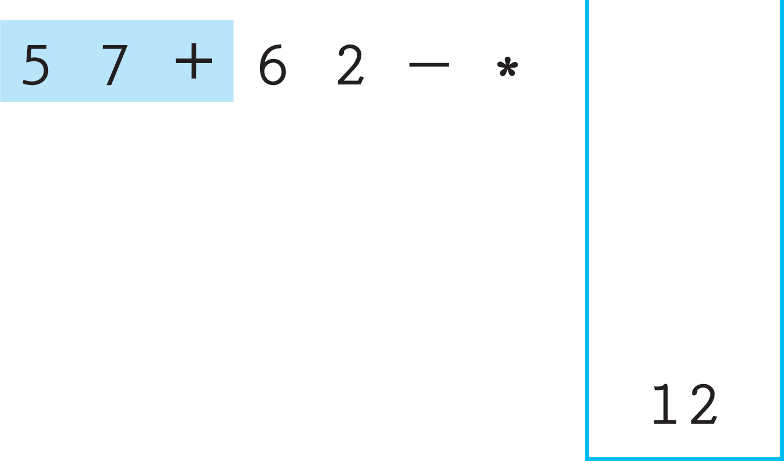
Example

Slide 83
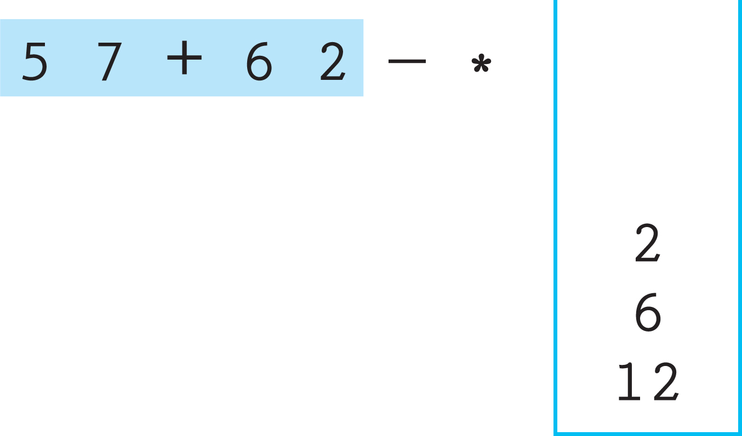
Example

Slide 84
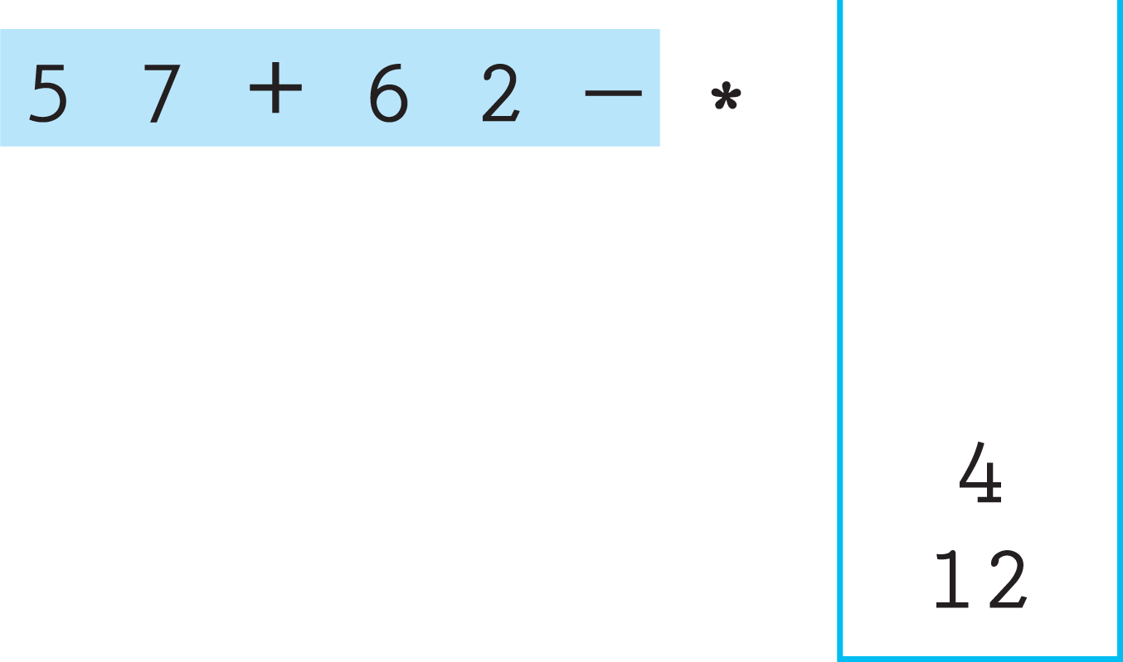
Example

Slide 85
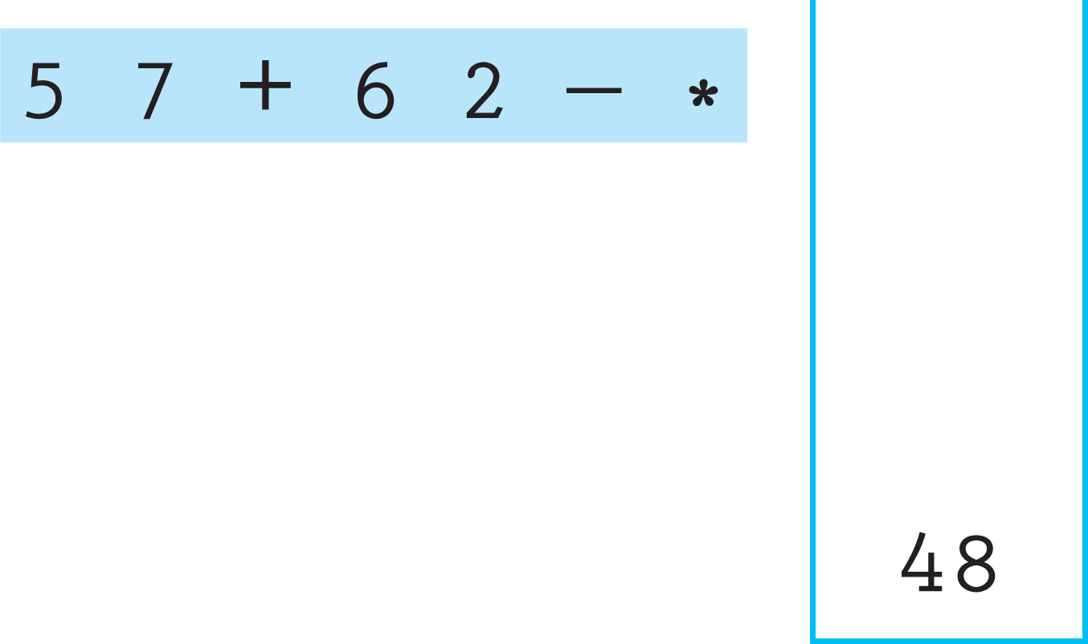

Slide 86
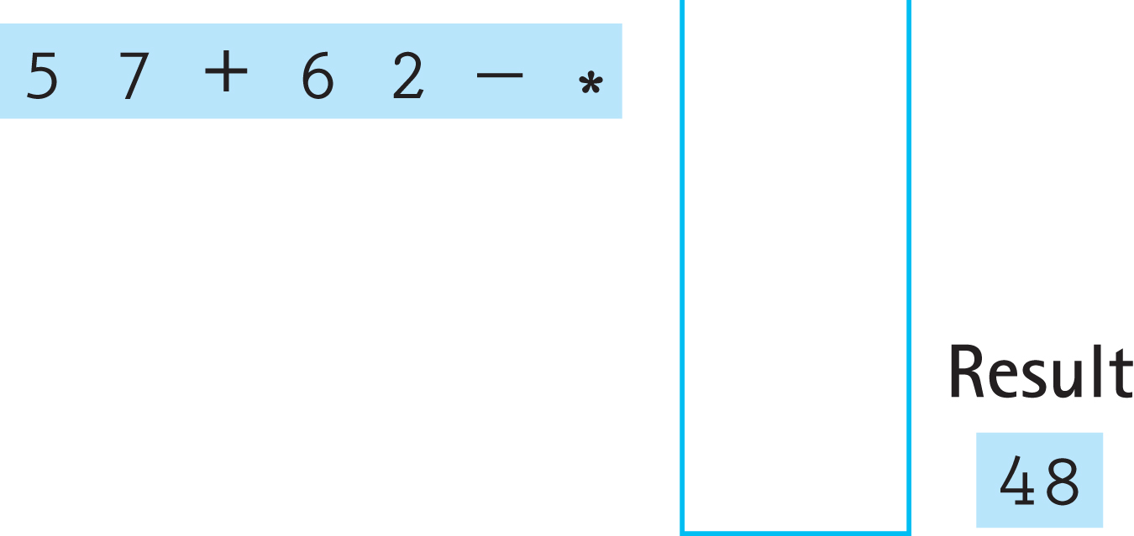
Example

Slide 87
Code and Demo
Instructors can now walk through and demonstrate the code contained in PostFixEvaluator.java from the ch02.postfix package and PFixCLI.java and/or PFixGUI.java from the ch02.apps package.

Slide 88
2.10 Stack Variations
Changes we could make to our Stack
Use stacks of class Object instead of generic stacks
Implement the classic pop operation (both remove and return top element) instead of the combination of pop and top operations
Instead of throwing exceptions we could
for example, state as a precondition that pop will not be called on an empty stack
for example, state that pop returns a boolean indicating success

Slide 89
The Java Collections Framework Stack
extends the Vector class which extends the Object class
inherits several useful operations such as capacity, clear, clone, contains, isEmpty, toArray, and toString.
in addition to our push and top methods, implements
the classic pop operation (both remove and return top element)
a search operation that returns the position of a specified object in the stack

